Slide 1



Predict Clicked Ads Customer Classification by using Machine Learning
Created by:
Ferry Setefanus
ferrysetefanus@gmail.com
https://www.linkedin.com/in/ferry-setefanus-257098170/
Data Science enthusiast with a bachelor's degree in information systems at STMIK Pontianak. Passionate in data science, data analysis, machine learning and loves learning new things related to technology. Have experience in warehousing field for 4 years. Currently looking for an opportunity to work in the data field.

Slide 2
Overview
"A company in Indonesia wants to know the effectiveness of an advertisement that they air, this is important for companies to be able to know how much the advertisement is marketed so that it can attract customers to see advertisements.
By processing historical advertisement data and finding insights and patterns that occur, it can help companies determine target marketing, the focus of this case is to create a machine learning classification model that functions to determine the right target customers "

Slide 3
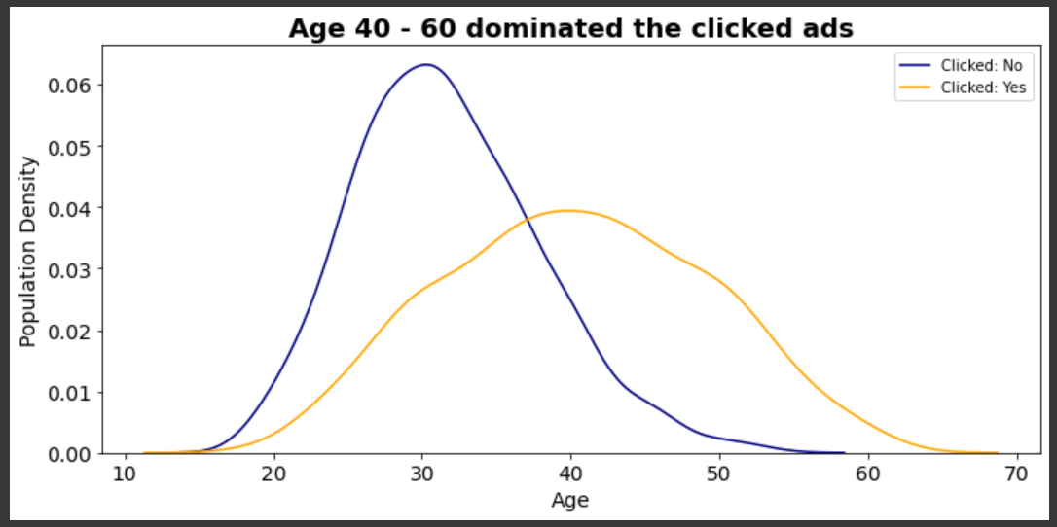
Customer Type and Behaviour Analysis on Advertisement
Although the majority of users are in their 30s, the users who have the highest probability of clicking are in their 40s - 60s.
For more details, see jupyter notebook here

Slide 4
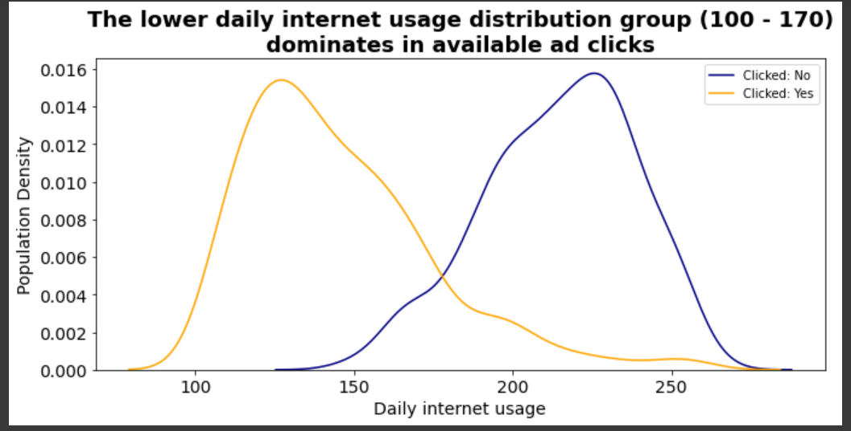
Customer Type and Behaviour Analysis on Advertisement
The lower daily internet usage distribution of the customer (100-170) dominates the clicked ads.
For more details, see jupyter notebook here

Slide 5
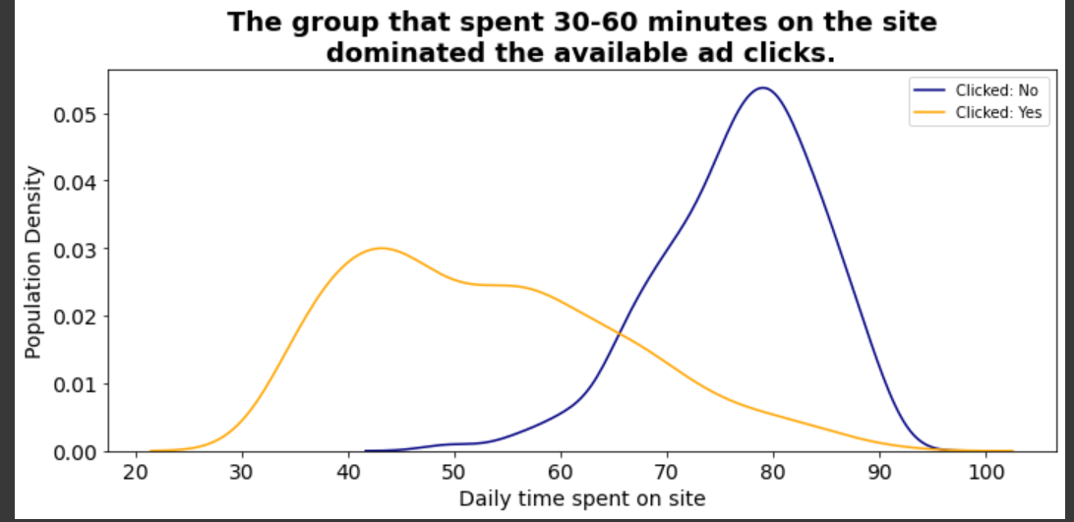
Customer Type and Behaviour Analysis on Advertisement
The lower the daily time spent on site values, the higher the probability of clicking the ad.
For more details, see jupyter notebook here

Slide 6
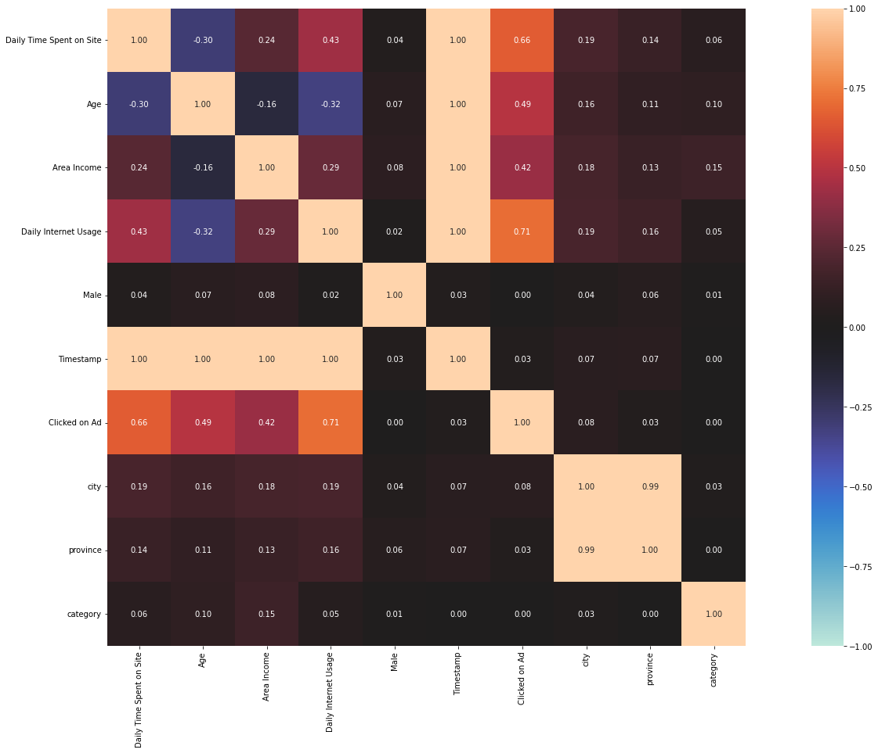
Customer Type and Behaviour Analysis on Advertisement
daily time spent on site, age, area income, and daily internet usage have the highest correlation to clicked on ads column.
For more details, see jupyter notebook here

